Slide 1
Match Group Inc. (MTCH)
A Preliminary Quantitative Analysis
Jack Wu, Quantitative Analyst Intern, Icarus Fund LLC.

Slide 2
Outline
Executive Summary
Major Competitors
Financial Highlights
Quantitative Analysis

Slide 3
Executive Summary
Historical Finance Transactions:
Company Highlights
Meetic Acquisition, 2011
Expanded Match Group
Background: Founded in February of 2009 by Thomas J. McInerney, Bernard Kim, and Gary Swidler, an operator of the world’s largest portfolio of e-dating sites, including but not limited to Tinder, Match.com, and Hinge. The company had an initial public offering in November, 2015.
into Europe
Tinder Acquisition, 2014
Strategy: Match Group maintains a diverse portfolio of e-dating sites that each cater towards a different demographic, widening the audience the company may interest. Match Group also invests heavily in marketing strategies to acquire more users.
Top growing application,
skyrocketing revenue
Objectives: Like any major company, Match Group seeks to expand. This entails the diversification of revenue sources, including paid subscriptions for premium features, etc. This also entails, evidently, acquisitions, expanding the monopoly Match Group has on the e-dating market. Future objectives include integrating AI for efficiency purposes, including but not limited to improved matchmaking.
PlentyOfFish Acquisition, 2015
Top growing application,
skyrocketing revenue
Major Stake in Hinge, 2018
Full Acquisition, 2019
Top growing application,
skyrocketing revenue
Match.com Acquisition, 2020
Top growing application,
skyrocketing revenue
Analysis: Given the company’s extensive, diversified portfolio of e-dating giants, with a proven interest in further embracing AI technologies, Match Group is in strong shape. Investment into this company’s equity is an investment well-made.
Hyperconnect Acquisition, 2021
South Korean AI technology company,
increasing AI capabilities, diversifying
portfolio

Slide 4
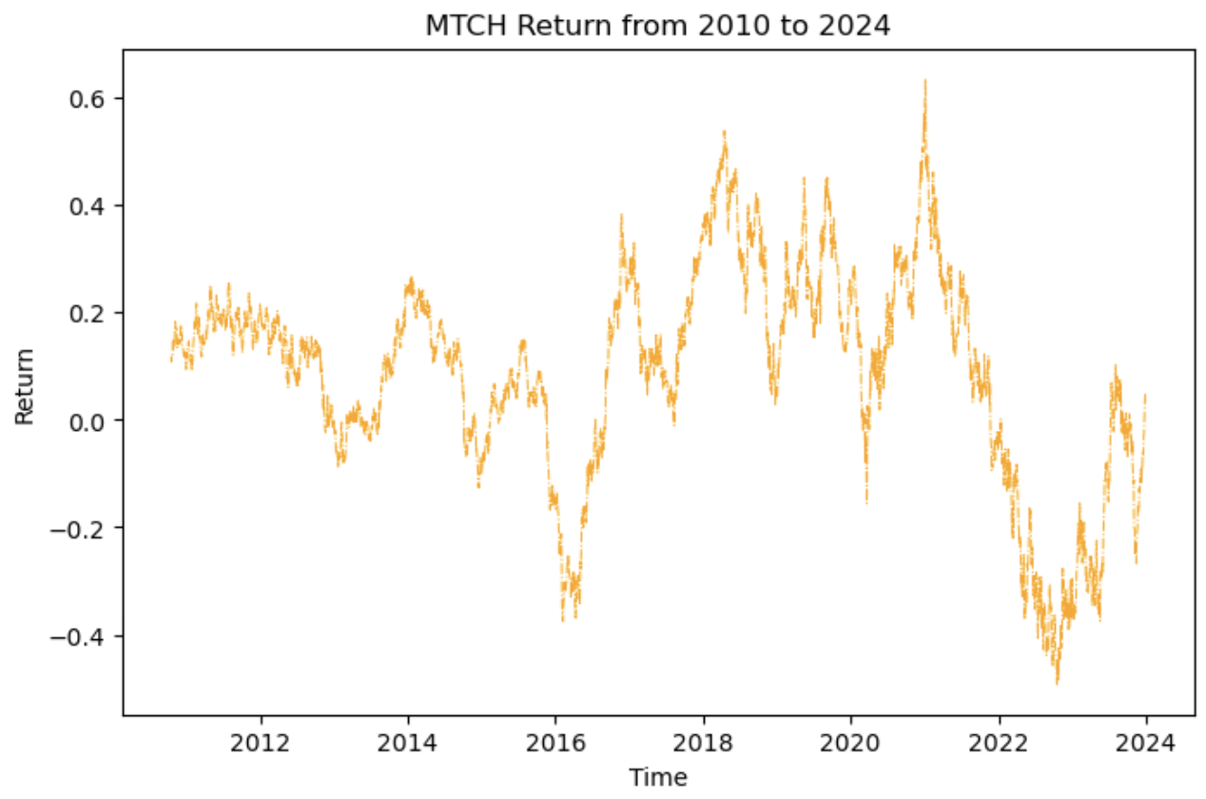
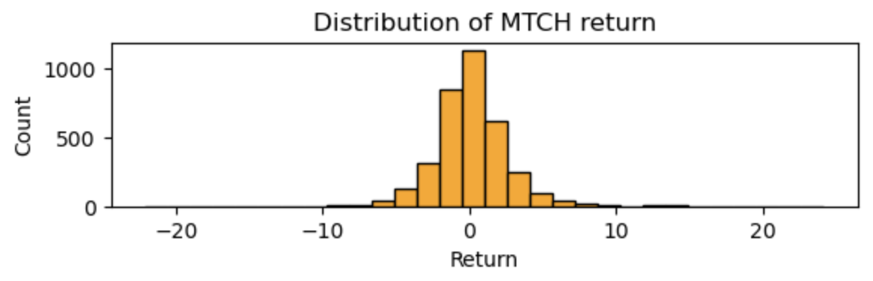
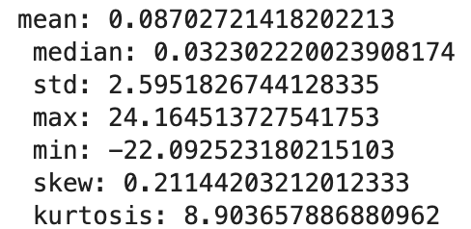
We qualitatively examine MTCH return over the last 12 years as time-series data, then as a histogram.
We note a sharp increase around 2016. From preliminary research, this appears to be the result of the acquisition of PlentyOfFish in 2015, which noticeably strengthened MTCH stock. Another sharp increase in 2020 can be attributed to the COVID-19 pandemic, where social interaction diminished and online interaction flourished.
We note a sharp decrease around 2021. From preliminary research, there was fear in the overvalued stock in dating apps that resulted from the COVID-19 pandemic. Investors sought equity in sectors that would flourish in post-pandemic times, and Match Group was left behind.
We note key features of the summary statistics. Firstly, the standard deviation and kurtosis are very high. This indicates high volatility in the stock, which can be qualitatively affirmed. The high kurtosis (>>3) indicates non-normality. As well, the mean is 8.7% while the median is 3.2%. The large difference indicates that there are proportionately more positive outliers to the right of the distribution bringing the mean higher.

Slide 5
Major Competitors
Bumble, e-dating application
eHarmony, e-dating application
OkCupid, e-dating application
Match Group’s biggest competitor.
Match Group’s second biggest competitor.
Match Group’s third biggest competitor.
Up until only earlier this year in May 2024, it was a key built-in feature for women to make the first move. This made women feel safer and created an overall positive and unique e-dating environment.
Uses a proprietary compatibility matching system (CMS) that is based on extensive research in psychological and social sciences. This helps with forming deeper connections that would attract consumers.
OkCupid’s unique DoubleTake feature gives users a panel of potential candidates rated with compatibility scores, which likely improves user experiences.
Bumble is in a strong financial stance, having grown 7.70% in 2023 and 8.90% in 2024 according to Yahoo Finance analysts.
Financial information was unable to be found.
Financial information was unable to be found.

Slide 6
Financial Highlights
Match Group Finances (from MarketWatch)
P/E ratio: 13.60 - The industry standard dictates an average from about 26.83 for the technology industry over the past 5 years. Match Group’s is lower than the industry standard. This indicates lower expectations from investors in terms of future growth.
EV/EBITDA: 10.98 - The industry standard dictates an average of about 12.2 as of 2023. The fact that Match Group is lower than the average indicates its relative attractiveness as a potential investment.
P/B: 10.97 - The industry standard dictates an average of 8.37 as of 2024 Q1. Match Group being on the higher side of this average again signals its potential for future earnings.
ROA: 14.99% - The industry standard dictates an average of 10.85% as of 2024 Q1. A higher ROA on Match Group’s part indicates strong efficiency in generating profits from current assets.

Slide 7
Weak-Form Market Efficiency
We fit a random walk model of the form R_t = R_t-1 + a + ℇ to the return data, where a is a constant and ℇ is white noise. We lag the return once.
We get an adjusted R squared value negligibly small, displaying as 0.000. The p-value of the F-statistic is 0.315 >> 0.05, and hence we fail to reject the null hypothesis and conclude that the model is not statistically significant.
Furthermore, we perform a Durbin-Watson test on the residuals from this random walk model to get a test statistic of 1.959. This is notably close to the value of 2, and hence we fail to reject the null hypothesis and conclude that there is no autocorrelation in the residuals.
We present this as evidence supporting the Weak-Form hypothesis. The lack of predictability indicates that analyzing past return prices do not provide more information about future movement.
We present this as evidence supporting the Weak-Form hypothesis. The lack of predictability indicates that analyzing past return prices do not provide more information about future movement.
To arrive at a more robust conclusion, we need to repeat this procedure considering higher order lags in the residual. This can better capture the inherent structure of the long-term data.

Slide 8
Quantitative Analysis
To model the seasonality of Match Group stocks, and more precisely the Day-of-the-Week Effect, we fit a linear regression model as such:
R_T = β_1 * D_(1,t) + β_2 * D_(2,t) + β_3 * D_(3,t) + β_4 * D_(4,t) + β_5 * D_(5,t) + ℇ_t,
where we define D_(1,t) = 1 if the return is on a Monday, 0 otherwise, D_(2,t) = 1 if the return is on a Tuesday, 0 otherwise, and so forth. ℇ_t is treated as stochastic white noise.
From a simple data preprocessing routine followed by an OLS linear regression fit, we begin to analyze the quality of our model in predicting the return from the day of the week.
The model does not well describe the relationship between the variables. This is evident from the negligibly small adjusted R squared value, displaying as -0.000, found upon inspection of the day-of-the-week fit for the data. This indicates that we may need to consider a higher order combination of the explanatory variables for a suitable model.

Slide 9
We can also use more statistical tools to determine if there exists a linear relationship between all the variables together with the Y, namely the F-statistic.
There does not appear to be a linear relationship between all X variables taken together with Y. Upon inspection of the fit summary statistics, we find an F-statistic of 0.7577 with P-value 0.580 >> 0.05 = our significance level.
The F-statistic being relatively low, not even reaching 1, combined with a significantly high P-value, suggests a lack of statistical significance in the linearized model choice, in turn implying that a model with no predictors is no worse.
This is likely an indication that the dependent variables chosen are not great selections for predicting the dependent variable, or that the phenomena is non-linear.

Slide 10
To validate our conclusions, we are also to analyze if the assumptions required for an OLS regression model to be appropriate hold for this particular model.
The first assumption we are to consider is that E(residuals)=0. In other words, the errors must have a mean of zero. In our model, the mean of the residuals is 0.0001548, which is arbitrarily close to zero. In practice, we can say that this criterion is satisfied.
We must also validate that the errors are linearly independent, and that there does not exist autocorrelation that would indicate unwanted dependencies.
The Durbin-Watson statistic of the residuals is 1.999, which is very close to 2. We fail to reject the state null hypothesis, suggesting a lack of autocorrelation. This criterion is satisfied.

Slide 11
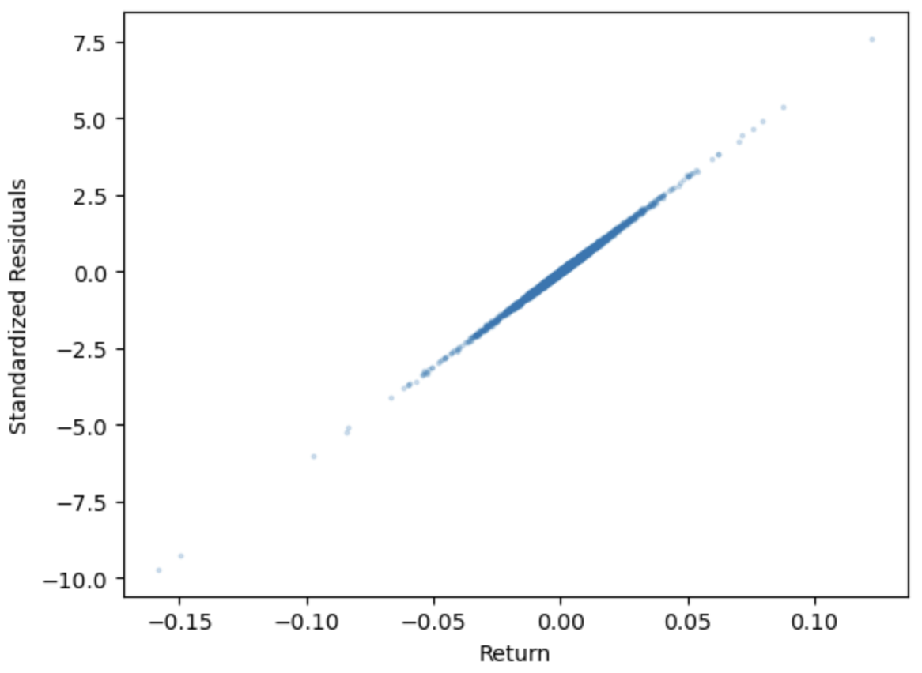
We must also validate that the variance of the residuals is constant and that heteroskedasticity is not present.
From qualitative observation, we find the lack of presence of heteroskedasticity, given the lack of the tell-tale cone shape data that indicates non-constant variance. This criterion is satisfied.

Slide 12
We are also to validate that there is no relationship between the residuals and the corresponding X variables. In other words, we check that Cov(u,x)=0. Indeed, we get a negligibly small value of 0.0002612, and hence this criterion is satisfied.
We are also to validate that the errors follow a normal distribution. This can be done with a simple Shapiro-Wilk hypothesis test. The null hypothesis is that the residuals follow the normal distribution.
We get a Shapiro-Wilk p-value of 1.8346e-35, which is much less than our 0.05 alpha threshold. Hence, we reject the null with high certainty and conclude that this criterion is not satisfied.
We finally must rule out multicollinearity. First, analyze the covariance matrix of the five explanatory variables. Observe that the entries for indices i != j are close to 0, indicating no linear relationship between explanatory variables.
The VIF are well below 10, all hovering around 1.28, and the tolerance, the reciprocal, is around 0.78, above 0.10. We conclude that there does not exist multicollinearity with high certainty. Although, the code may need to be revisited, since it is curious that all the VIF values are the exact same for each day of the week.
We conclude that the assumptions required for OLS regression are not fully satisfied, which can explain the inadequacy of the model.

Slide 13
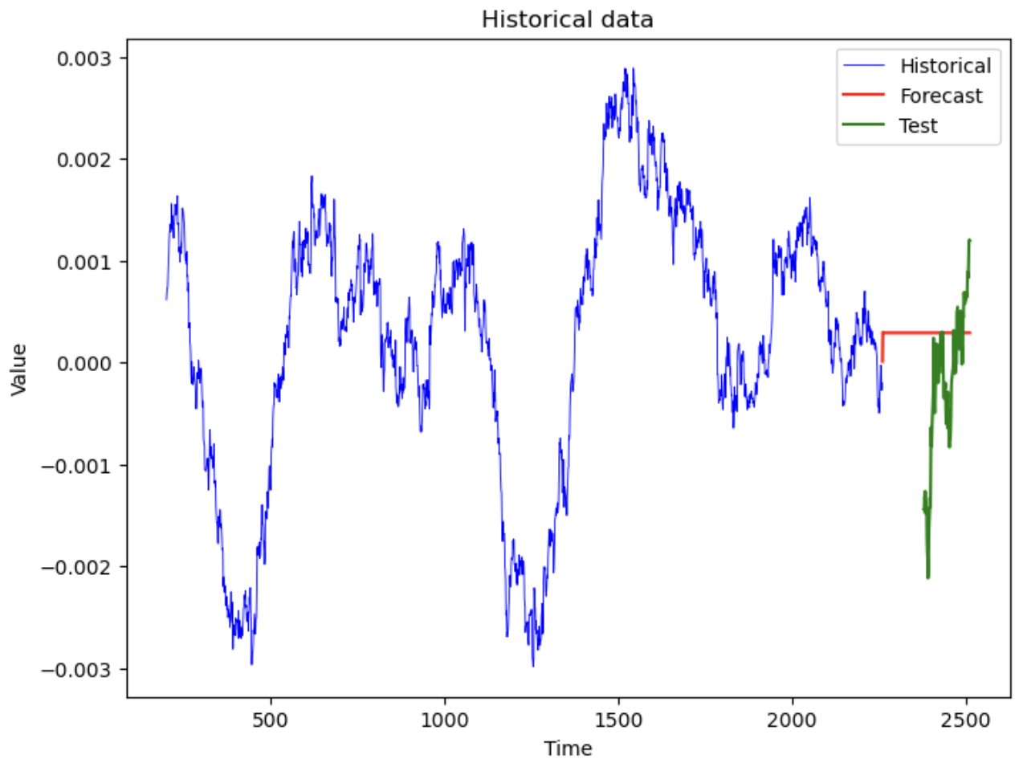
ARIMA Fit
We implement an ARIMA fit in Python trained with 90% of the data to forecast the last 10%.
Note that the forecast increases then flattens out, whereas the real-world data continues growing at a sharp rate when you glue the right end of the training data with the left end of the testing data.

Slide 14
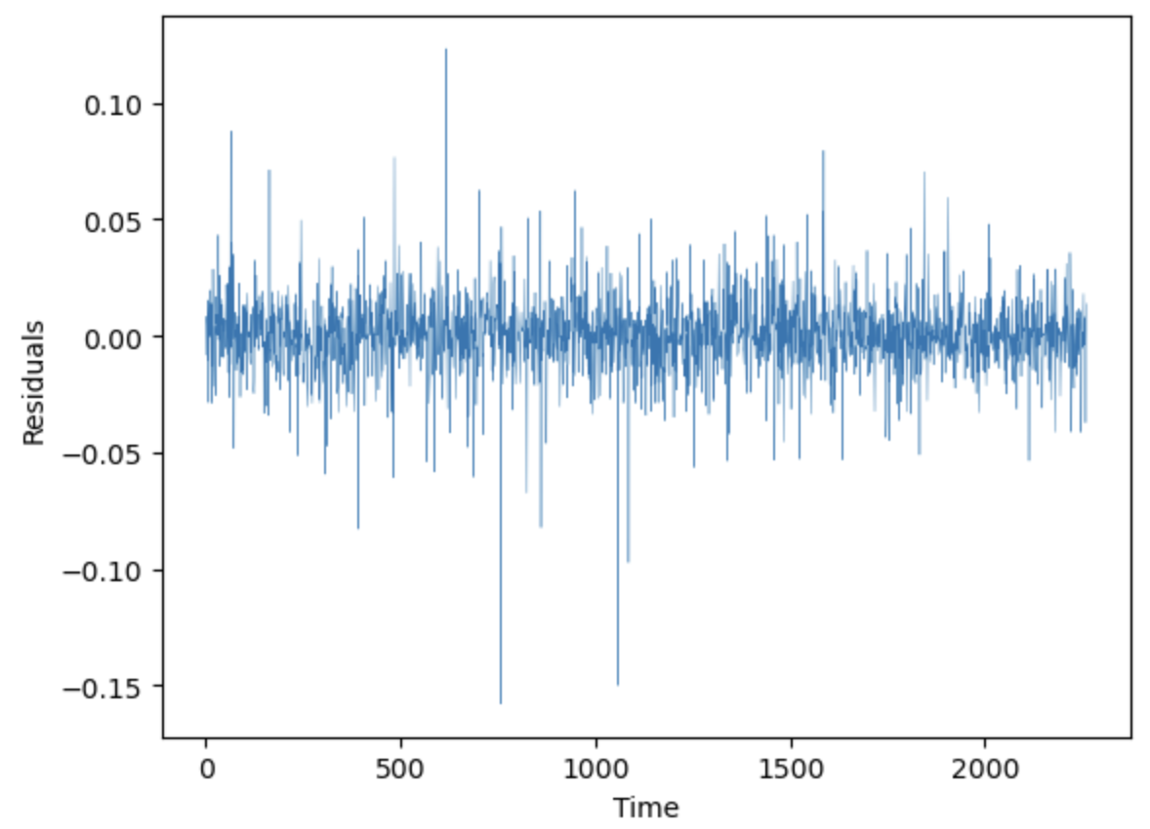
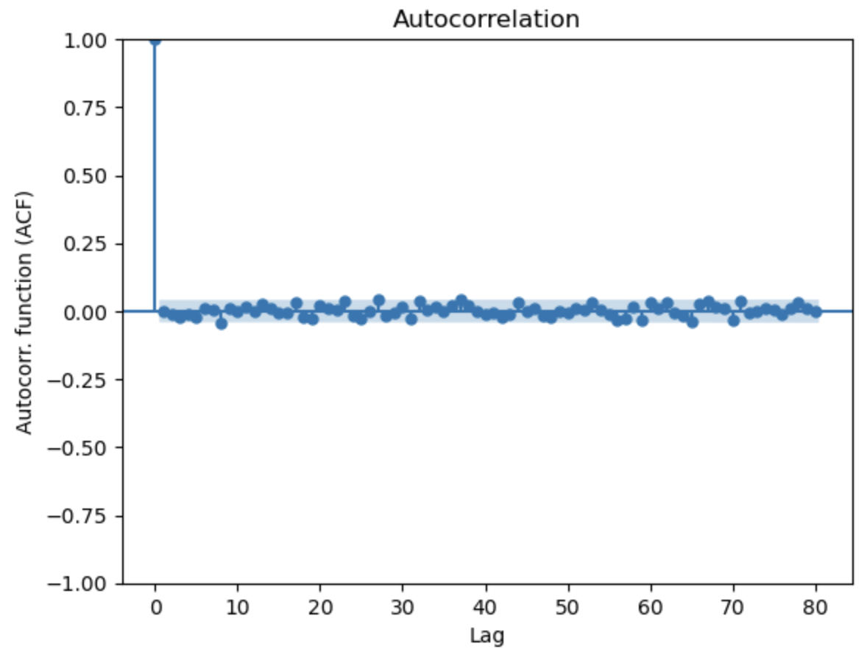
Residuals
We observe white noise behaviour in the residuals of the ARIMA fit with the testing data. This indicates that ARIMA well captures the data.
We observe the absence of outliers in the ACF plot past 0 lag, where the blue-shaded region represents the 95% confidence interval. We conclude that there is an absence of autocorrelation.
This supports the independence of values at distinct times, affirming the weak market efficiency hypothesis. More precisely, we affirm that analyzing past stock prices does not provide extra information about future movement.
We may not conclude anything about seasonality from the autocorrelation plot alone. Additional statistical tests are needed.

